Slide 1
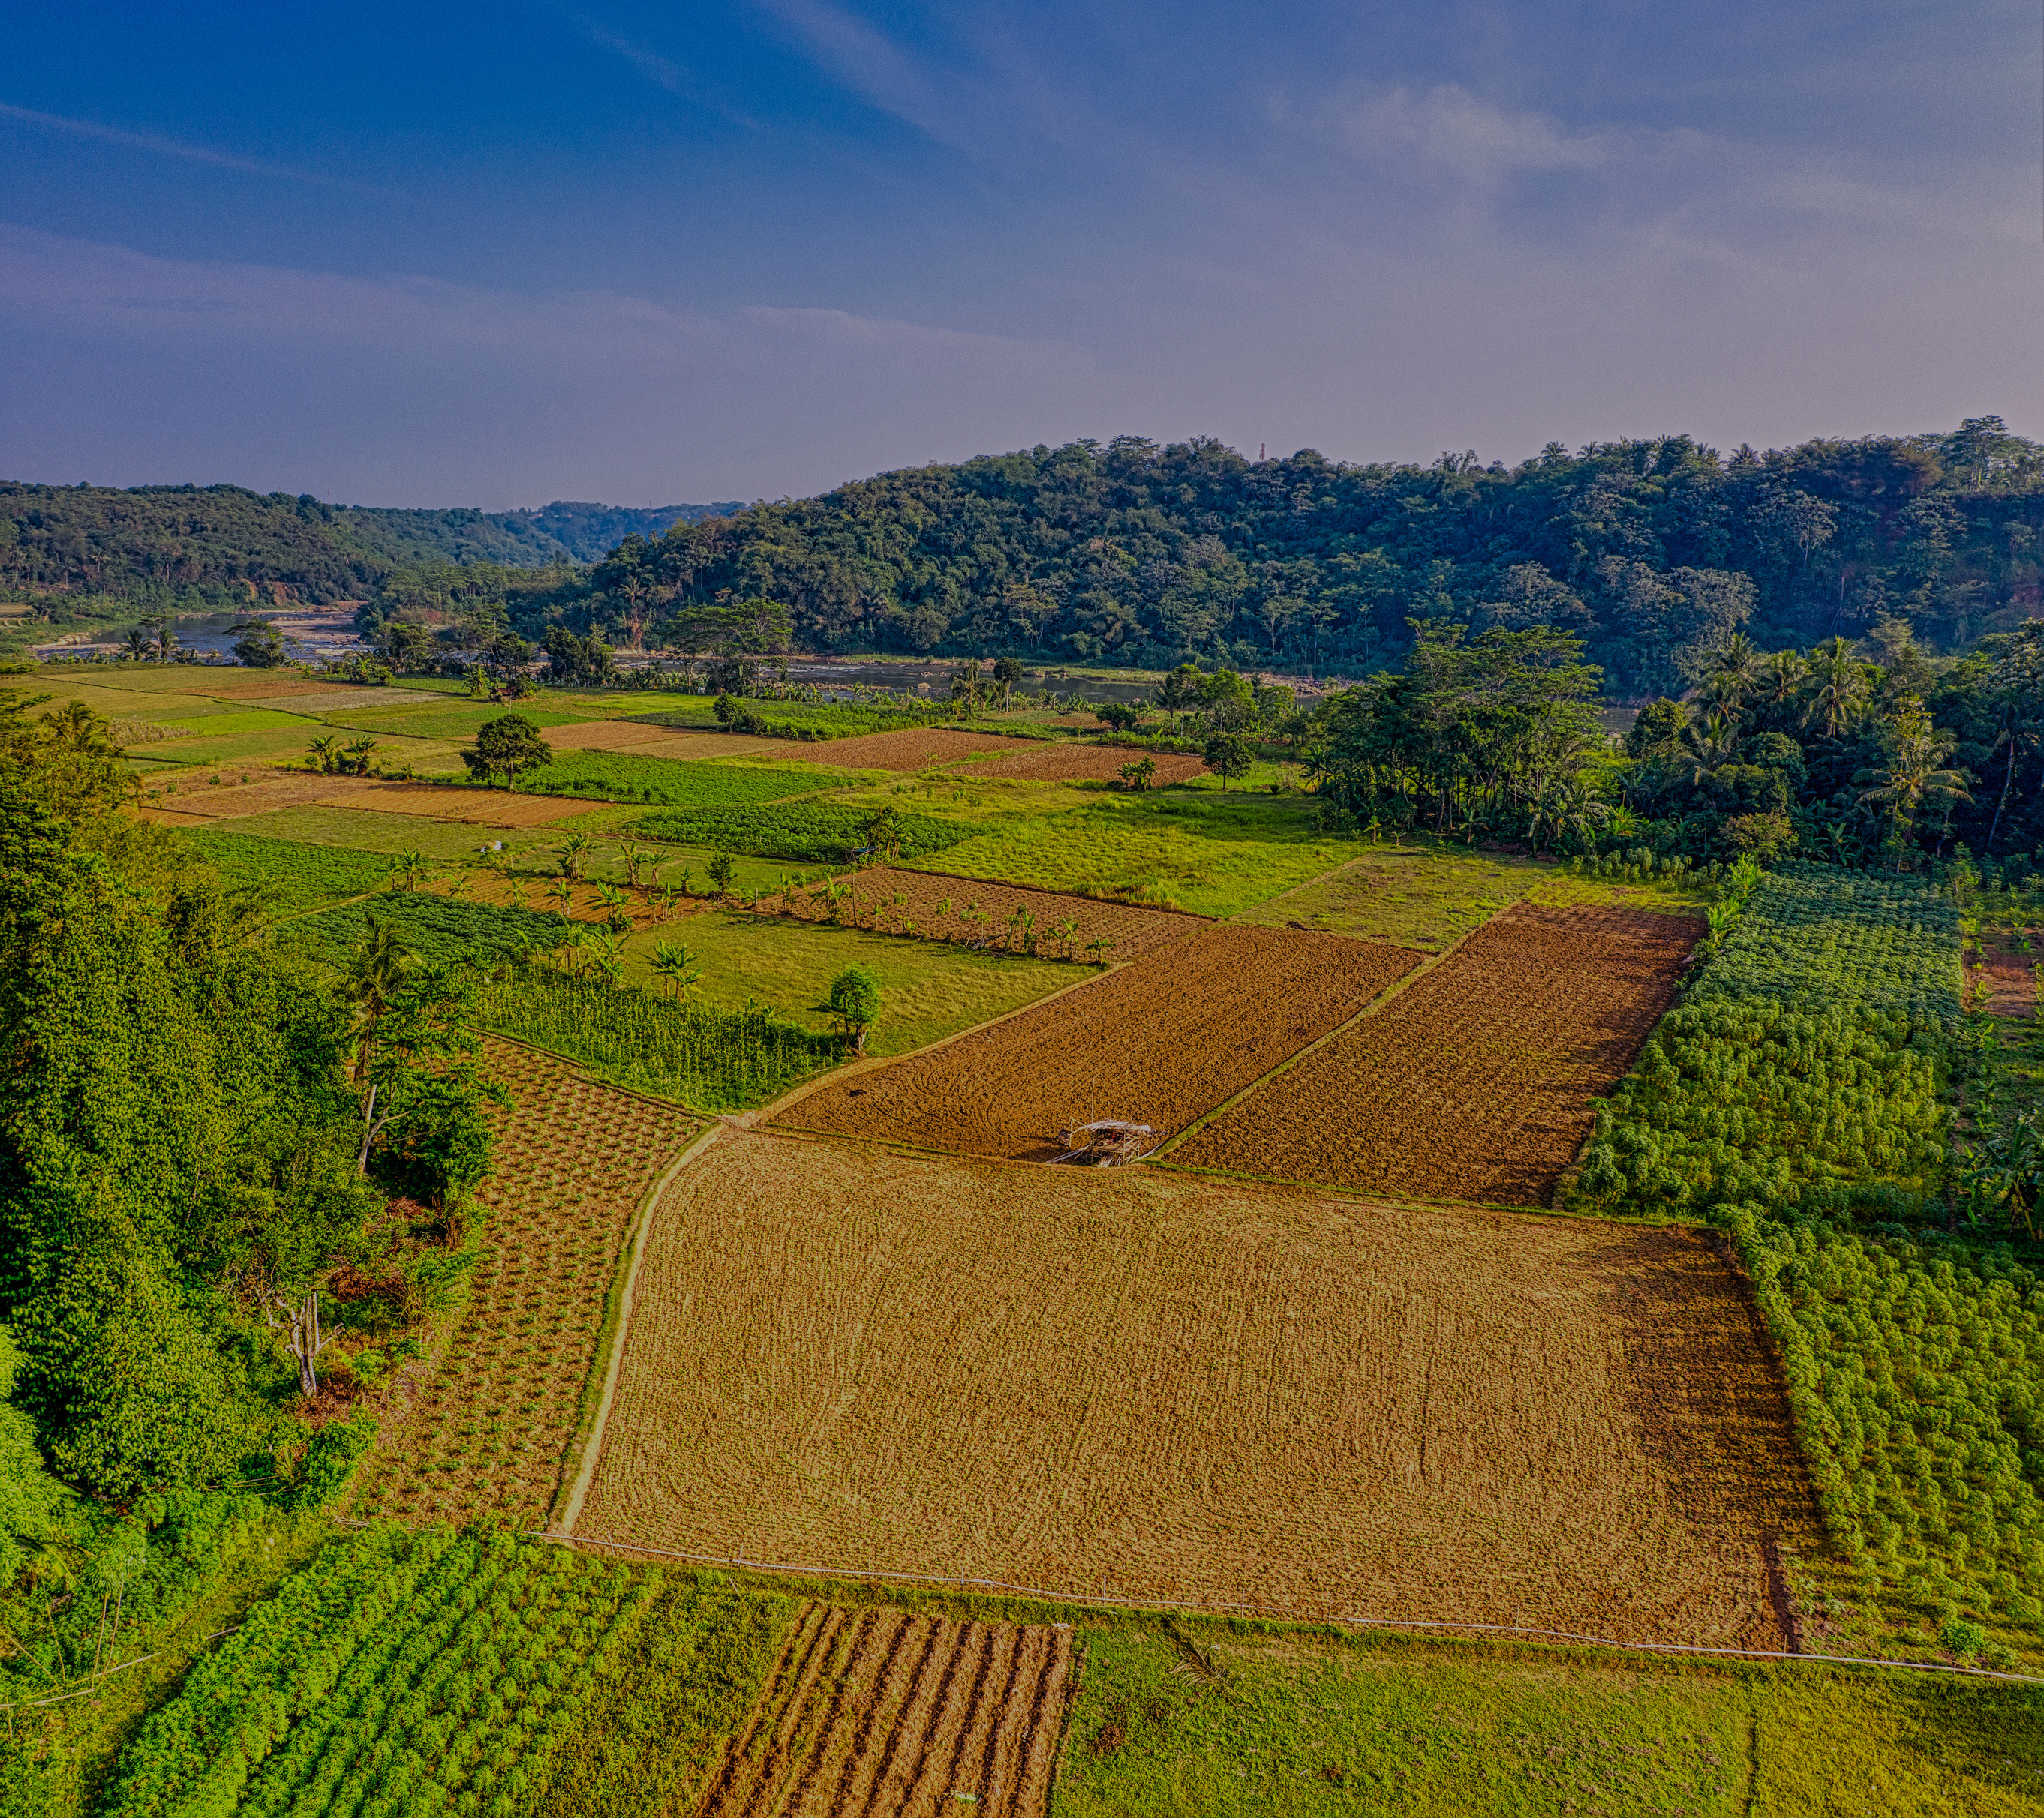

SWIIS-Drone
AGRITECH
Smart Weather Integration Irrigation System-Drone

Slide 2

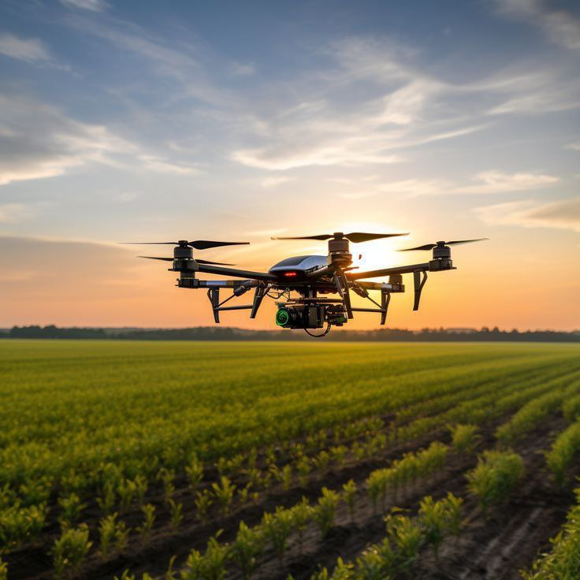
SWIIS-Drone
BACKGROUND
Agriculture is one of the most water-dependent industries in the world, and inefficient irrigation is a major contributor to water wastage. Farmers face challenges such as unpredictable weather conditions and limited access to real-time crop health information. SWIIS was created to address these challenges by harnessing AI and machine learning technologies. With the ability to process vast amounts of data in real-time, SWIIS helps farmers make decisions that optimize water usage and improve crop outcomes, contributing to a more sustainable agricultural ecosystem.

Slide 3
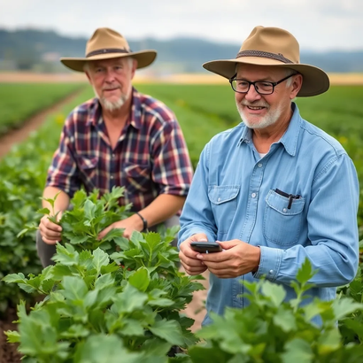
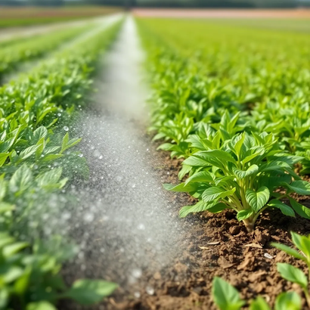
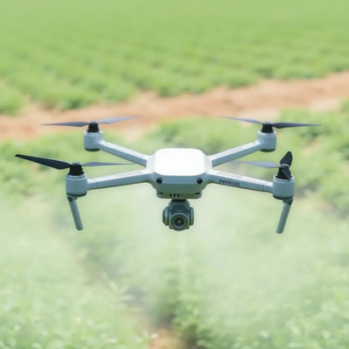
SWIIS-Drone
Farmers struggle with inconsistent irrigation due to a lack of accurate data on soil and weather conditions.
PROBLEM DEFINITION
Inefficient irrigation can lead to wasted water, damaged crops, and decreased yields, which are detrimental to farm productivity.
SWIIS addresses these problems by using data-driven recommendations to ensure accurate and timely irrigation, maximizing crop growth and minimizing water waste.

Slide 4
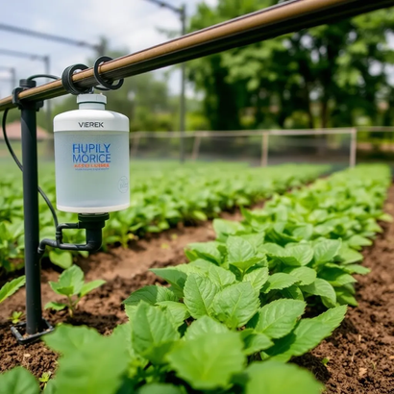
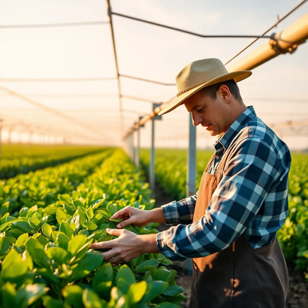
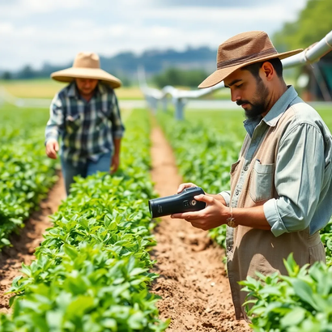
SWIIS-Drone
PROJECT SERVICES
BENEFITS
OBJECTIVES
SUCCESS CRITERIA
Water conservation through efficient irrigation.
Healthier crops and higher yields.
Reduced manual intervention, saving time and effort.
Supports a more efficient and sustainable agricultural process.
Enhance crop management through data-driven irrigation.
Minimize water consumption while maximizing crop yield.
Automate irrigation to reduce labor.
Increased productivity through better crop yields.
Water usage efficiency: Target a 20% reduction.
Automation: Reducing manual labor in the irrigation process.

Slide 5
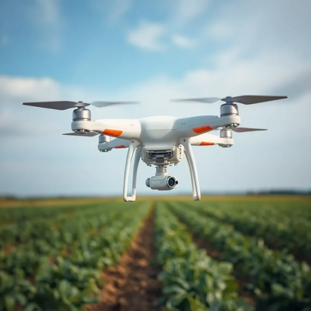
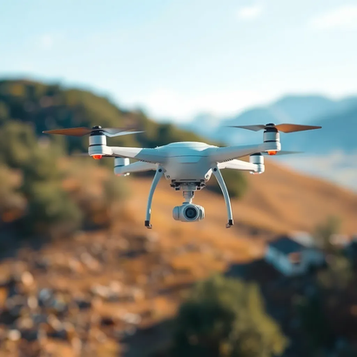
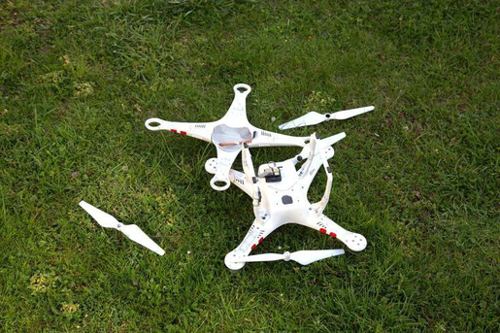
SWIIS-Drone
PROJECT FACTORS
REQUIREMENTS
CONSTRAINTS
RISKS
Hardware: Drones with cameras and environmental sensors.
Software: AI models for data analysis and prediction.
Data: Real-time weather, soil moisture, and crop health metrics.
.
High initial investment for drones and AI system development.
Availability and accuracy of data for model training.
Environmental factors, such as extreme weather, affecting drone operations
Technical risks: Drone malfunctions and communication failures.
Data security: Unauthorized access to sensitive information.
Regulatory risks: Compliance with aviation and environmental laws

Slide 6

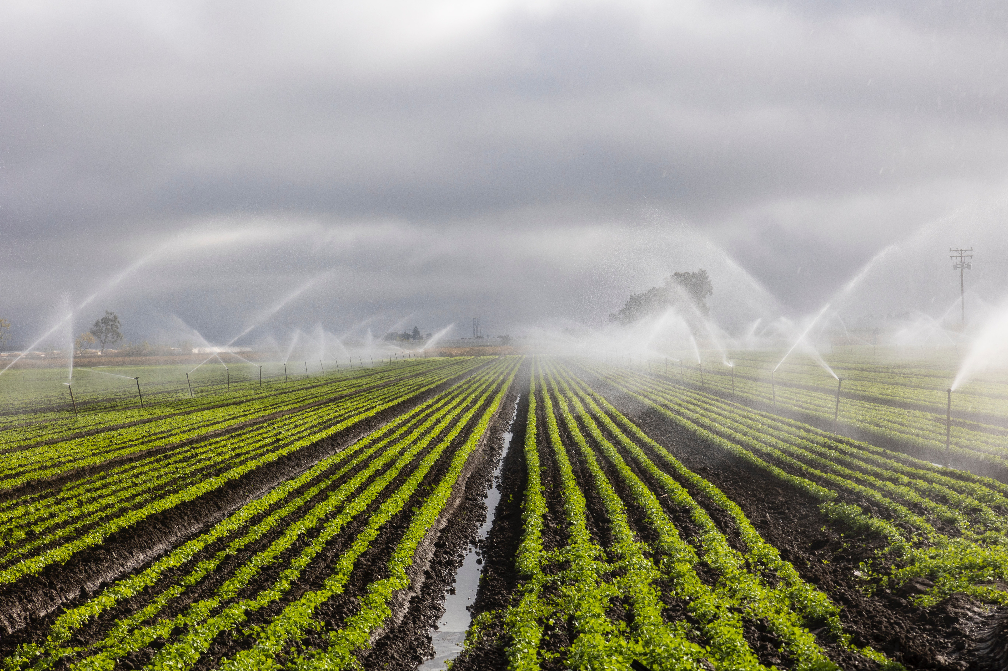

SWIIS-Drone
TOOLS AND TECHNIQUES
Tools:
Drones equipped with high-definition cameras and sensors for field monitoring.
Machine learning frameworks such as TensorFlow and PyTorch for data analysis and model training.
Weather and soil data APIs for real-time environmental monitoring.
Techniques:
Deep learning for image recognition and data prediction.
Reinforcement learning for route optimization and decision-making.
Time-series forecasting for predicting weather and soil moisture trends

Slide 7
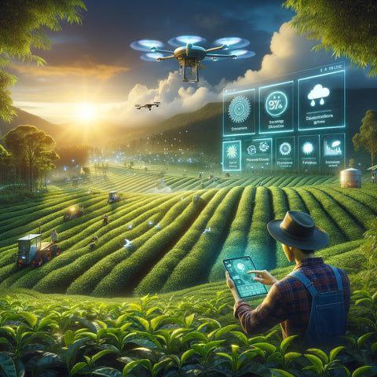

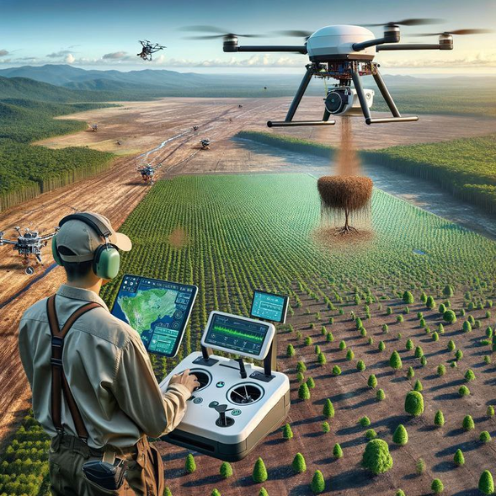
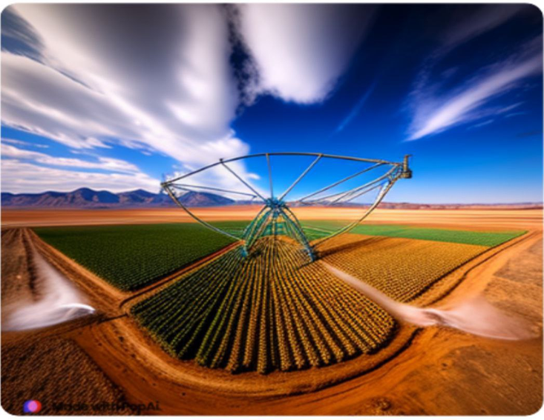
SWIIS-Drone
THE MACHINE LEARNING APPROACH, DATA, AND MODEL
Data Collection: Use APIs and IoT sensors for weather, soil, and crop data.
Preprocessing: Clean data and enhance diversity.
Feature Engineering: Select key features like soil moisture.
Data Labeling: Label data with expert input.
Predictive Modeling: Use regression, decision trees, and deep learning.
Weather & Soil Analysis: Apply LSTM for time-series and ensemble models.
Decision-Making: Implement rule-based systems and reinforcement learning.
Real-Time Integration: Ensure real-time data processing and sensor fusion.
Continuous Learning: Update models and incorporate feedback.

Slide 8
DEEP LEARNING APPROACHES
SWIIS-Drone
Weather Analysis: Convolutional Neural Networks (CNNs) analyze satellite images to detect weather patterns that affect irrigation needs.
Object Detection: YOLO models are used to detect objects in drone-captured images, identifying areas requiring more or less irrigation.
Semantic Segmentation: U-Net models segment the field into different zones, providing precise irrigation control.
Route Planning: Deep reinforcement learning helps drones navigate fields efficiently, saving time and reducing operational costs.

Slide 9

SWIIS-Drone
TIME SERIES ANALYSIS
Long Short-Term Memory (LSTM) models are used to predict future weather conditions and soil moisture trends.
These models allow the system to forecast irrigation needs and adjust schedules accordingly.
The AI model continuously learns from past data, improving its predictions over time.

Slide 10
SWIIS-Drone
Route Optimization: AI identifies the most efficient flight paths, ensuring timely and energy-efficient irrigation.
Automated Landing and Takeoff: Autonomous systems handle takeoff and landing, reducing risks and improving reliability in diverse terrains.
Crop Health Monitoring: The system tracks crop growth and detects irregularities, recommending adjustments to the irrigation schedule.
SOLUTION TECHNIQUES

Slide 11
SWIIS-Drone
CONCLUSION
SWIIS provides a comprehensive AI-driven solution to optimize irrigation and improve agricultural outcomes.
By leveraging real-time data, automation, and machine learning, SWIIS enables farmers to conserve water and maximize productivity.
The system promotes sustainable farming by reducing water waste, improving crop yields, and automating irrigation tasks.

Slide 12
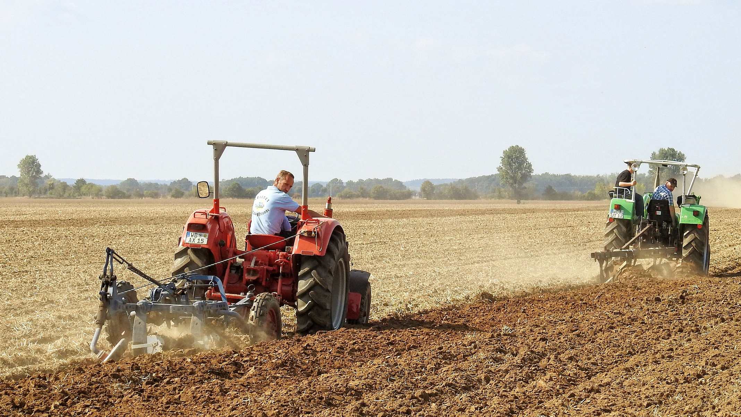

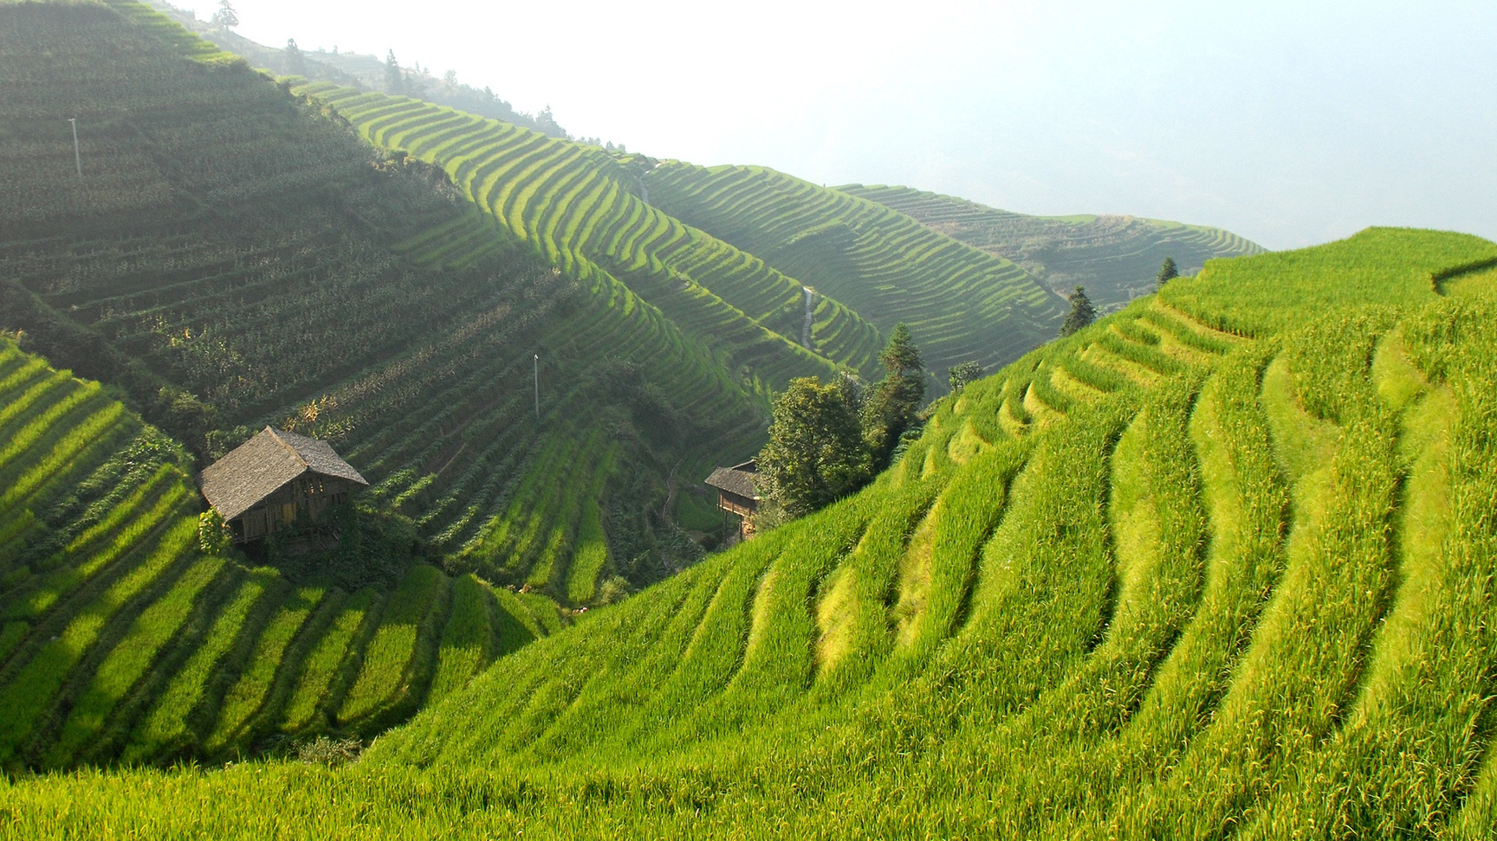


SWIIS-Drone
CONTACT US
+123-456-7890
www.agritech.com
SWIIS@AGRITECH.COM
5 CASSANDRA, BEDWORTH PARK VEREENIGING

Slide 13
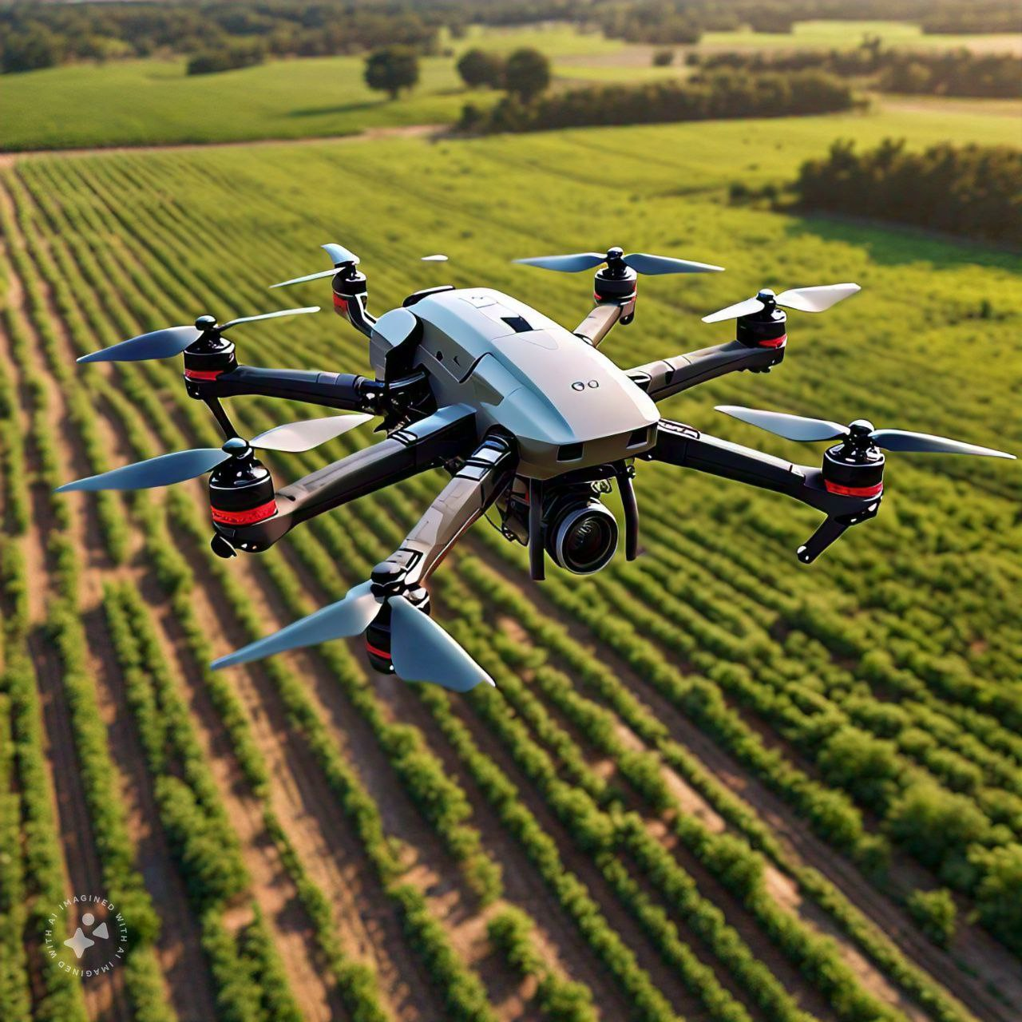
SWIIS-Drone
THANK YOU!!

